Slide 1

The 10 Most Common Azure Mistakes (and how to fix them)
scottsauber
Slides at scottsauber.com

Slide 2
Audience
Anyone using Azure
Technically some of these translate to AWS too

Slide 3
Agenda
Series of lightning talks
Account Organization
Naming Standards
Tagging Standards
Azure Policies
Managed Identities
DefaultAzureCredential
Requiring TLS 1.2+
Federated Credentials
Budgets and Cost Alerting
Reservations
Savings Plans

Slide 4
Goals
Ideas on how to make your Azure more maintainable, cost effective, and more performant
At least one idea that you can go implement immediately at work

Slide 5




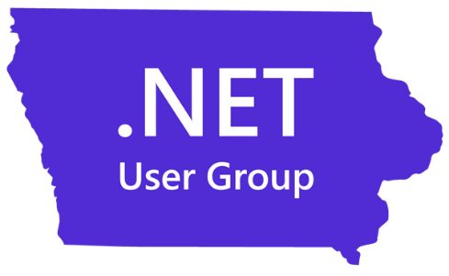
Who am I?
Director of Engineering at Lean TECHniques
Microsoft MVP
Dometrain Author
Redgate Community Ambassador
Co-organizer of Iowa .NET User Group

Slide 6

Why this talk?

Slide 7
Account Organization

Slide 8
Problem: Account Organization is a mess
Account Organization
One Subscription to rule them all
Subscriptions named by app sometimes and by team other times
Resource Groups with no real structure

Slide 9
Solution: Develop Account Organization Strategy
Account Organization
Subscriptions - It Depends™️
Minimum: per environment boundaries
Maximum: per team per environment boundaries
Resource Groups – always per app per environment
Service Groups – new as of May 2025
Fancy tags
Overlay to pull together across subscriptions, resource groups, etc – ie “Production apps” or “PCI Scope” or “MyApp”
Start doing this for your next app and slowly migrate

Slide 10
Naming Standards

Slide 11
Problem: Naming is a mess
Naming Standards
Naming has no consistency across apps, teams, divisions
Hard to find things – slows troubleshooting
Not pleasant on the eye at a glance

Slide 12
Solution: Implement a Naming Standard
Naming Standards
Microsoft has a recommended naming convention based on recommended abbreviations
Example: app-navigator-dev-001 for an application called Navigator, that’s an App Service running in the Dev env
Azure has a naming tool you can run
AzureNamingTool
More important that you pick something and be consistent
Enforce with Azure Policy (more soon)

Slide 13
Tagging Standards

Slide 14
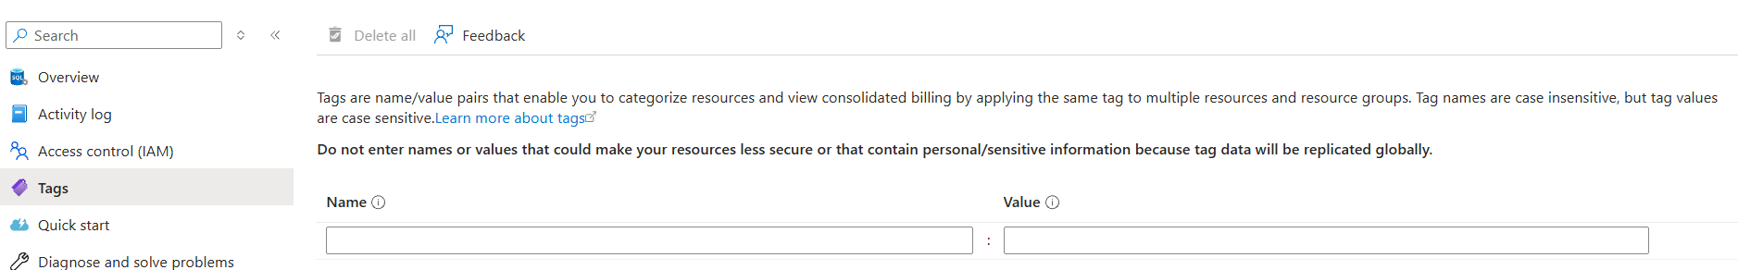
Problem: Tagging is a mess
Tagging Standards
Tags are metadata about the resource
No consistent tags
Makes it hard to answer questions like:
How much does this app cost me a month?
How much does the Dev environment cost me a month?`
Who owns this resource?

Slide 15
Solution: Implement a Tagging Standard
Tagging Standards
Define a common set of Tags to be used on each resource
Common tags:
Environment (Dev, Test, Production)
Owner (so.andso@contoso.com)
BusinessUnit (Finance, Sales, etc)
Application (CRM, PaymentsPortal, etc)
CostCenter (abc123, etc)
ServiceClass (Tier1, Tier2, etc)
Enforce with Azure Policy (more soon)

Slide 16
Azure Policies

Slide 17
Problem: We aren’t enforcing our standards
Azure Policies
You have a document defining standards
But it’s not followed
Wild West

Slide 18
Solution: Azure Policies
Azure Policies
Azure Policies can enforce your naming standards
And your tagging standards
Can have multiple Policy Effects:
Deny resources from being created - PREFERRED
Audit - flag it as non-compliant
Modify – auto change it – DON’T DO THIS
Can ensure resources are configured correctly too
Ensure HTTPS enforcement
SQL has Data Encryption at rest turned on

Slide 19
Managed Identities

Slide 20
Problem: We are managing credentials
Managed Identities
Credentials to manage – create, store, rotate, revoke
Azure SQL still using SQL Auth – username + password
Key Vault still using Client ID + Client Secret
Someone might accidentally commit a secret

Slide 21
Solution: Use Managed Identities
Managed Identities
Managed Identities allow you to give a resource an “identity” (user to run as essentially)
These Identities are managed completely by Azure – no username/password/client id/client secret needed
Assign a Managed Identity to an App Service/Function/etc
Give that Managed Identity access to read secrets, connect to a DB, etc
Completely passwordless
In your code you can use DefaultAzureCredential to do the right thing (more on this later)

Slide 22
DefaultAzureCredential

Slide 23
Problem: People use DefaultAzureCredential…
DefaultAzureCredential
…without knowing the tradeoffs
DefaultAzureCredential is meant to get you into Azure as quickly as possible
The downside is – performance

Slide 24
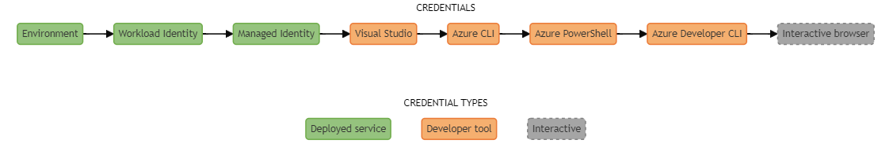
Problem: People use DefaultAzureCredential…
DefaultAzureCredential

Slide 25
Solution: Be explicit about credentials
DefaultAzureCredential
Locally – use AzureCli or VisualStudioCredential… else use ManagedIdentity
… or use Excludes on DefaultAzureCredential
This will save you ~2-10 seconds when interacting with the credential
DefaultAzureCredential Best Practices
My blog post on this in 2022

Slide 26
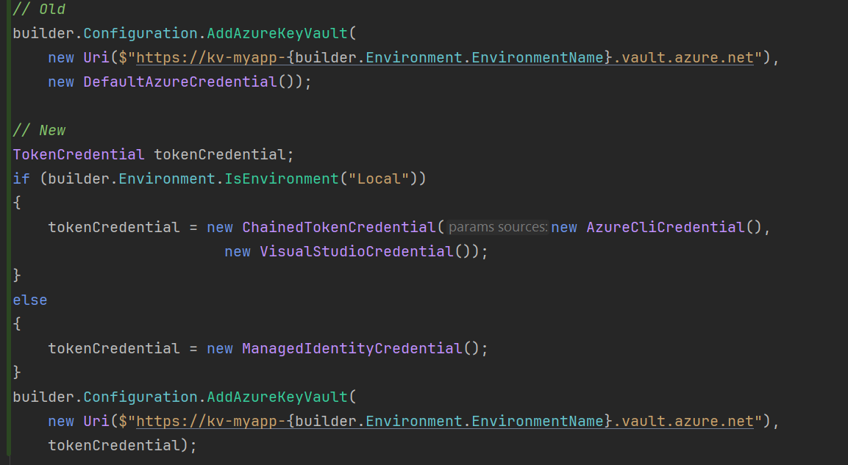
Solution: Be explicit about credentials
DefaultAzureCredential

Slide 27
Requiring TLS 1.2+

Slide 28
Problem: Not requiring TLS 1.2+
Require TLS 1.2+
HTTPS has underlying encryption algorithms to encrypt your data in transit
These encryption algorithms have continually gotten better and better
Not requiring TLS 1.2+ allows users to connect to your app with insecure protocols
Example – people on older browsers
This allows a man-in-the-middle attacks for people to decrypt in real time, exposing your data

Slide 29
Solution: Require TLS 1.2+
Require TLS 1.2+
Require TLS 1.2+ on all your relevant resources (ie app service, function apps, storage accounts, etc)
Make sure you also enforce a good cipher suite
ie TLS_ECDHE_RSA_WITH_AES_128_GCM_SHA256 and TLS_ECDHE_RSA_WITH_AES_256_GCM_SHA384
TLS 1.3 is the latest, most browsers in the last 4-5 years support 1.3
SSL Labs to test your site - https://www.ssllabs.com/ssltest/

Slide 30
FederatedCredentials

Slide 31
Problem: Not using Federated Credentials
Federated Credentials
Your CI/CD pipelines need to auth to Azure to provision resources, deploy, etc
Without Federated Credentials, you’re managing a Client ID + Client Secret (most likely)
All the same issues managing credentials (create, store, rotate, revoke)
If someone gets these credentials, they can manipulate your Azure environment

Slide 32
Solution: Use Federated Credentials
Federated Credentials
Federated Credentials allows you to “trust” repositories to push to Azure
Passwordless
Short-lived tokens (minutes)
High level:
Create an App Registration or User Managed Identity
Create the Federated Credential to whitelist an org/repo
Assign that App Reg / UMI to the subscription / resource group with appropriate permissions
In the pipeline YAML “confirm” sharing of tokens
How to do this with GitHub Actions

Slide 33
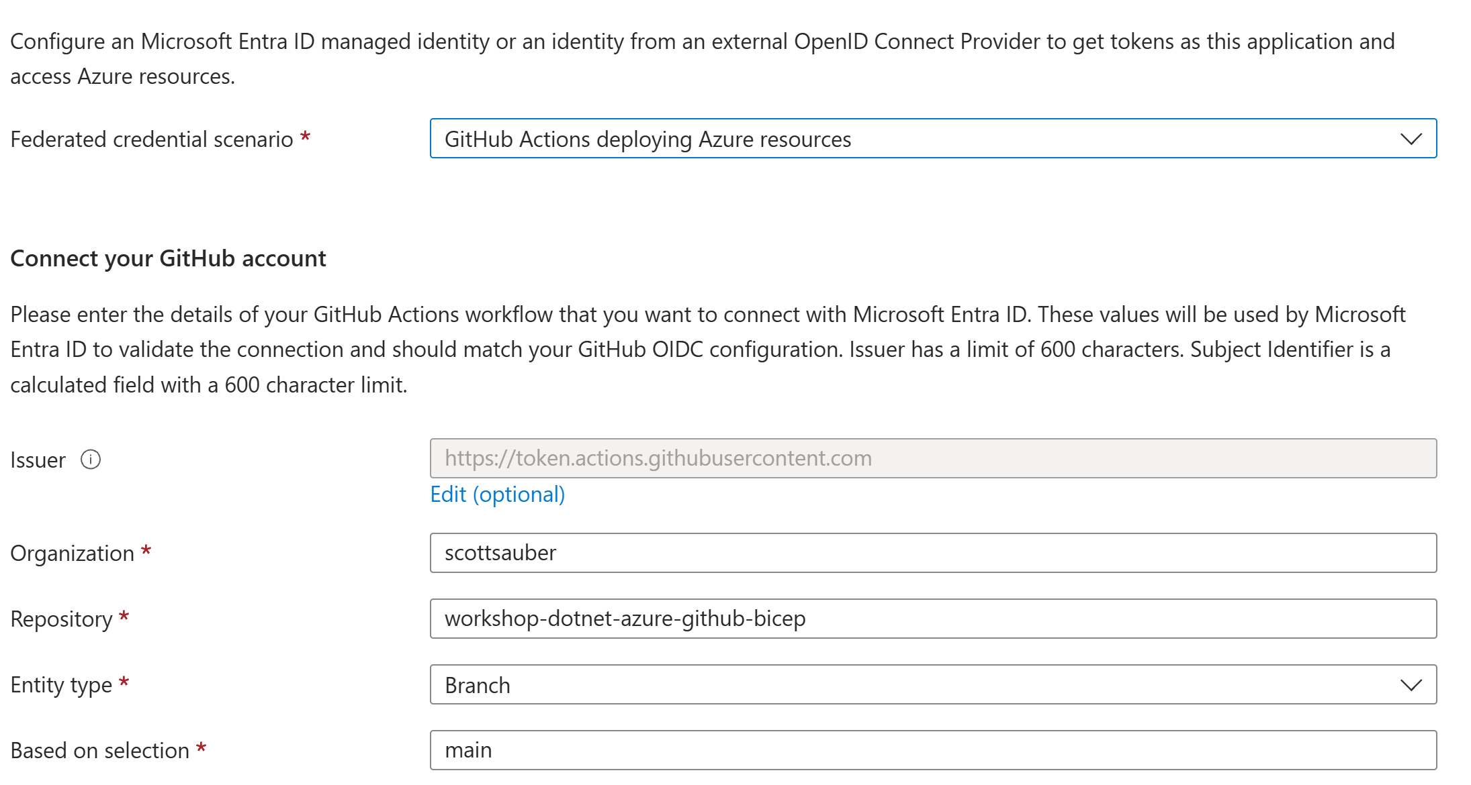
Solution: Use Federated Credentials
Federated Credentials

Slide 34
Budgets and Cost Alerts

Slide 35
Problem: Cost isn’t managed in Azure
Budgets and Cost Alerts
Sudden, unexpected bills
No early warning for forecast overrun
Lack of visibility across teams
Missed anomalies and fraud detection

Slide 36
Solution: Use Azure Budgets
Budgets and Cost Alerts
Define a spending threshold for a scope (ie Subscription or Resource Group)
Tracks actual or forecasted against that target over a time period (monthly, quarterly yearly)
Can have multiple thresholds, 50%, 80%, 100%
Can trigger Action Groups (email, Functions, Webhooks)
Budgets are a bad name – does not stop resources, only monitoring + triggers
Can lag by 24 hours

Slide 37
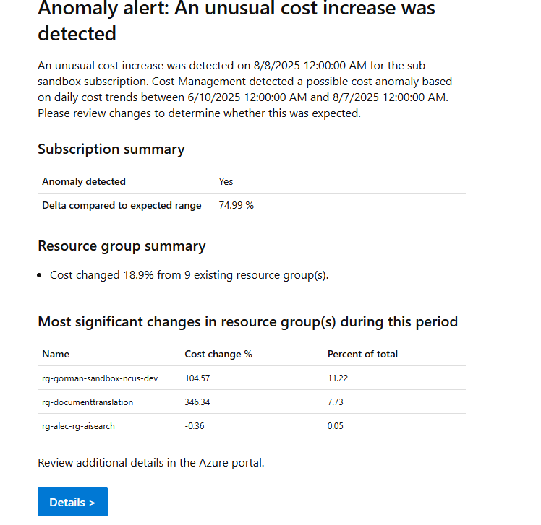
Solution: Use Azure Cost Alerts
Budgets and Cost Alerts
Anomaly Detection

Slide 38
Azure Reservations

Slide 39
Problem: Cost is getting too high
Azure Reservations
Cloud isn’t always cheaper up front
Sometimes cloud is about speed, lower TCO, and visibility

Slide 40
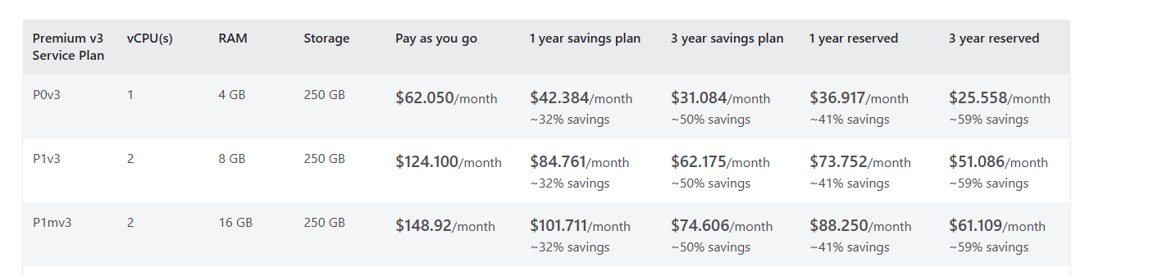
Solution: Azure Reservations
Budgets and Cost Alerts
Commit to using certain resources for 1 year or 3 years, get a discount between 20% - 70% depending on the resource (App Service Plans, SQL, VMs, Cosmos, etc)
Downside – what if you get rid of the resource after 2 years but you committed to 3
Still pay monthly or up front (if you want)

Slide 41
Azure Savings Plans

Slide 42
Problem: Cost is getting too high
Azure Savings Plans
Cloud isn’t always cheaper up front
Sometimes cloud is about speed, lower TCO, and visibility

Slide 43
Solution: Azure Savings Plans
Azure Savings Plans
Commit to using certain spend $ for 1 yr or 3 yrs, get a discount
Can be used however you want across eligible resource types

Slide 44
Comparing Savings Plans vs Reservations
Azure Savings Plans
Reservations give you more savings, but more risk if you need to change your plans
I recommend everyone use at least Savings Plans
Go tell your boss you can cut the Azure bill by at least 20% and get a promotion
Comparison of a single P0V3 App Service Plan:
 | Pay As You Go | Savings Plan | Reservation
1 year | $62.05/mo | $42.38/mo (32%) | $36.92/mo (41%)
3 year | $62.05/mo | $31.08/mo (50%) | $25.56/mo (59%)

Slide 45

Real benefits of these practices
1 company went from a request lead time of 1 month for new infrastructure to ~30 minutes
Another company reduced their overall Azure cost by almost 80%
Reduced need of manual security provisioning due to Azure account organization cascading rules
Increased security posture
Improved application performance
scottsauber

Slide 46
Takeaways
Hopefully you got at least one idea today you can take back to work
This slide deck is your resource – up at scottsauber.com
scottsauber

Slide 47

Questions? ssauber@leantechniques.com @scottsauber.com on Bluesky @scottsauber on Twitter
Schedule time with me to ask questions:
Slides at scottsauber.com
scottsauber

Slide 48
Thanks!
Slides at scottsauber.com
scottsauber

